Slide 1
Red Team Case Study
Bacchus Winery
CSD310
Module 12.2
July 22, 2022
By Chris McCracken, Joshua Frazier, James Brown, and Taylor Reid

Slide 2
Group Introduction and Case Briefing
Red Team based our case study on Bacchus Winery on the following facts given:
Stan and Davis inherited ownership of the winery and need to improve products and customer service using new business methods.
Bacchus Winery grows the grapes needed to make a Merlot, a Cabernet, a Chablis, and a Chardonnay.
Supplies for use around the winery are received from three different suppliers.
Bacchus Winery needs a better way to track these supply shipments and see if orders are not arriving on time.
Bacchus Winery needs a way to see what wines are selling and at what distributors.
Bacchus Winery needs to be able to see how many hours each employee has worked in each of the last four quarters.

Slide 3
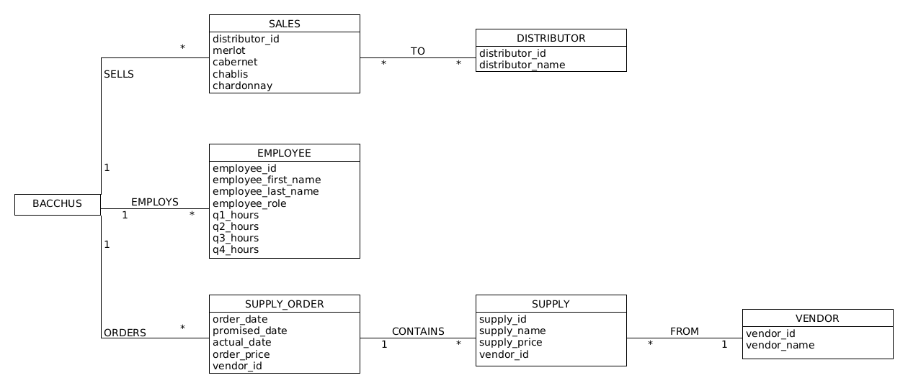
ORD:

Slide 4
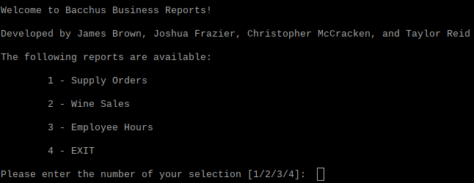
Business introduction and summary
Bachus Winery Case Study: The Bacchus’ are interested in a snapshot of the business to provide them the state of inventory, distribution, and employee hours. The reports are structured as follows:
Supply Orders Report
Wine Sales Report
Employee Hours Report

Slide 5
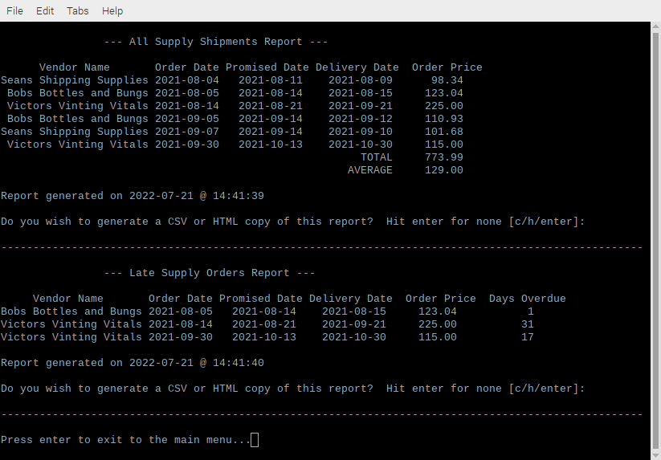
Supplies Delivery Reports
The deliveries reports display a listing of all supply deliveries, as well as a subreport of which of those deliveries were late, and by how many days.
The assumption was made that deliveries arrive on different dates due to the amount of time that it takes to inventory and put away supplies.

Slide 6
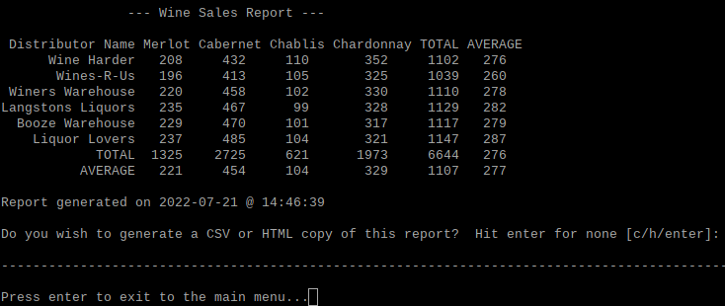
Wines Sold Report
Wines Sold Report shows how many bottles of each type of wine were sold at each distributor, as well as:
Total bottles sold of each type of wine
Average bottles sold of each type of wine
Total bottles sold by each distributor
Average bottles sold by each distributor
The assumption made here is that every distributor carries every wine, but that they may not sell evenly.

Slide 7
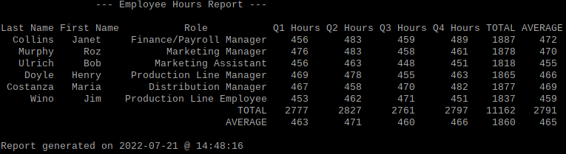
Employee Hours Report
The Employee Hours Report displays how many hours each employee worked in each quarter, as well as:
Total hours per year, per employee
Average hours per quarter, per employee
Total hours worked per quarter
Average hours worked per quarter
The assumption made here was that each employee worked in only one role.

